Slide 1
Stylometric De-Anonymization Techniques For Model Authorship
Apoorv Chandurkar
Kunwardeep Singh

Slide 2
Motivation
Recent developments in Language models have lead to creation of state of art models that can generate text based on the input context
However, these models can also pose problems of it being misused to generate fake text
Due to concerns about malicious use of GPT models, OpenAI decided not to release the full model in public
These models don’t even require to train based on the domain
There needs to be a system that can detect the fake text and attribute it to the model that was used to generate it. Can Stylometry help?
No such classification task done before to the best of our knowledge

Slide 3
Background: Stylometry
Oxford dictionary defines stylometry as ‘the statistical analysis of variations in literary style between one writer or genre and another’
Each person has their own writing style based on the vocabulary, length of sentences, word patterns that are used subconsciously
This technique is used to identify the original author of some text when the author information is missing
This project aims to identify the language model used to generate the text (if any) using the same stylometry technique

Slide 4
Language Models
A statistical language model is the probability distribution over a sequence of words, sentences, etc
These language models are capable of generating texts from random input texts and can form a coherence over a page of text
Optionally, some of them can be fine-tuned to generate text for a particular domain
In this project, we have used the following models to generate data:
GPT by OpenAI
GPT 2 by OpenAI
XLNet by Google/CMU

Slide 5
The Dataset
The OpinRank Review Dataset from UCI has hotel and car reviews from TripAdvisor and Edmonds websites
2000 reviews for each model (GPT-1, GPT-2 and XLM) were used as input and we generated a total of 6000 fake reviews
Dataset had to be cleaned from encoding issues, non recognizable characters and large texts
To generate the text, HuggingFace Transformers library based on PyTorch was installed in the Hypergator’s Tensorflow module

Slide 6
GPT 2 Sample Text
Real Review | Generated Review
This is a good place for those who want to spend a fun weekend in downtown Chicago without spending too much. I would say it is a better place for adults traveling without children, because most of those staying there when we were there (a Saturday night in summer) seemed to be there to go out to the bars, etc., and there was some noise at night from the people across the hall from us coming and going. The room was an adequate size, clean enough. The bed and pillows were not particularly comfortable. I don't think they had | This is a beautiful place, gorgeous bar and should really be somewhere to visit! I am officially off the service list! Too many people leaving! So we decided to stop by to find out what that was like here. It was a Great Friendly Night and we enjoyed all the delicious food for the week. The bartenders are fantastic! We could never get enough of that amazing Chicago fare! We finished our drink and shared a drink - Coke Snacks. This will be my 2nd time visiting and

Slide 7
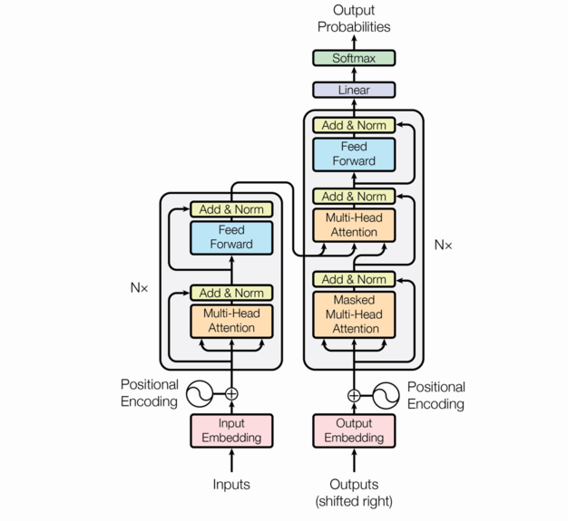
Transformer Architecture
Building block of all the SOTA Language models.
Uses Encoder-decoder architecture with a powerful concept called ‘Self Attention’.

Slide 8
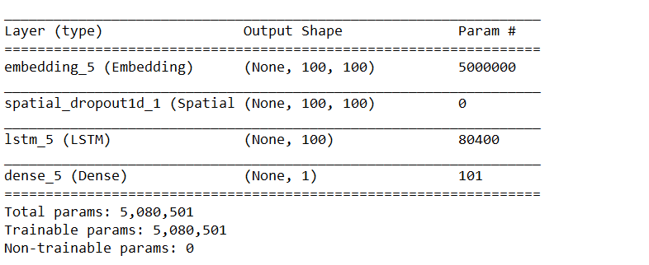
Network Architecture
We used LSTM architecture which is a standard NN architecture for text classification.

Slide 9
Results
Accuracy results:
GPT / GPT - 2: 88.25%
GPT - 2 / Human written text: 93.25%
GPT / GPT - 2 / XLNET: 83.05%
This result indicates classifier captures difference between the probability distribution of different models.
While all accuracies are higher than random chance, there is room for improvement.

Slide 10
Qualitative findings and Conclusion
Factors affecting the process of text generation and subsequent classification:
Architecture
Input prompt given to the Language models
Domain of the text being classified
Improving accuracy by increasing scale

Slide 11
Questions?

